Slide 1

Gradient Methods

Slide 2






Gradient Methods
Iterative algorithm minimizing $f:ℛ^{n}→ℛ$
$$f(x_{k})$$
Gradient: $f$ increases more in this direction than any other $d$.
$−∇f(x)$: the direction of searching for minimizer
Level set $f\left(x\right)=f(x_{k})$
gradient
$$x_{k}$$
tangent vector
$$x_{k+1}=x_{k}−α∇f(x_{k})$$
Remark:
The gradient tend to zero
Gradient descent algorithm

Slide 3









Steepest Descent
$$α_{k}=argmin_{α≥0}f(x_{k}−α∇f\left(x_{k}\right))$$
From $x_{k}$ a line search in the direction of $−∇f(x_{k})$ until a minimizer is found
Proposition.
If $x_{k}$ is a steepest descent sequence for a given function $f:ℛ^{n}→ℛ$, then for each $k$ the vector $x_{k+1}−x_{k}$ is orthogonal to the vector $x_{k+2}−x_{k+1}$.
$$x_{1}$$
$$f\left(x\right)=f(x_{2})$$
$$f\left(x\right)=f(x_{1})$$
$$x_{2}$$
$$x_{0}$$
$$f\left(x\right)=f(x_{0})$$

Slide 4








Steepest Descent
Proposition.
If $x_{k}$ is a steepest descent sequence for a given function $f:ℛ^{n}→ℛ$ and if $∇f(x_{k})≠0$, then $f\left(x_{k+1}\right)<f\left(x_{k}\right).$
Descent property
Stopping criterion:$∇f(x_{k})=$0？
$|f\left(x_{k+1}\right)−f(x_{k})|<ε$
$\frac{|f\left(x_{k+1}\right)−f(x_{k})|}{|f\left(x_{k}\right)|}<ε$
$\frac{|f\left(x_{k+1}\right)−f(x_{k})|}{max⁡\{\left|f\left(x_{k}\right)\right|,1\}}<ε$
$\left|\left|x_{k+1}−x_{k}\right|\right|<ε$
$\frac{\left|\left|x_{k+1}−x_{k}\right|\right|}{|\left|x_{k}\right||}<ε$
$\frac{\left|\left|x_{k+1}−x_{k}\right|\right|}{max⁡\{\left|\left|x_{k}\right|\right|,1\}}<ε$
Example: $f\left(x_{1}, x_{2}, x_{3}\right)=(x_{1}−4)^{4}+(x_{2}−3)^{2}+4(x_{3}+5)^{4}$

Slide 5



Steepest Descent
$f\left(x\right)=\frac{1}{2}x^{T}Qx−x^{T}b$, where $Q∈ℛ^{n×n}$ is a symmetric positive definite matrix
$∇f\left(x\right)=Qx−b$
$F\left(x\right)=Q=Q^{T}>0$
We set
$x_{k+1}=x_{k}−α_{k}g_{k}$,
where
$g_{k}=∇f(x_{k})$ and
$α_{k}=argmin_{α≥0}f\left(x_{k}−αg_{k}\right)$
$=argmin_{α≥0}(\frac{1}{2}(x_{k}−αg_{k})^{T}Q\left(x_{k}−αg_{k}\right)−(x_{k}−αg_{k})^{T}b)$

Slide 6





Steepest Descent
We set
$x_{k+1}=x_{k}−α_{k}g_{k}$,
where
$g_{k}=∇f(x_{k})$ and
$α_{k}=argmin_{α≥0}f\left(x_{k}−αg_{k}\right)$
$=argmin_{α≥0}(\frac{1}{2}(x_{k}−αg_{k})^{T}Q\left(x_{k}−αg_{k}\right)−(x_{k}−αg_{k})^{T}b)$
$$α_{k}=\frac{{g_{k}}^{T}g_{k}}{{g_{k}}^{T}Qg_{k}}$$
$$g_{k}=∇f\left(x_{k}\right)=Qx_{k}−b$$
Examples: ${x_{1}}^{2}+{x_{2}}^{2}$
Examples: $\frac{1}{5}{x_{1}}^{2}+{x_{2}}^{2}$

Slide 7

Analysis of Gradient Methods
Globally convergent
Locally convergent
Rate of convergence
$V\left(x\right)=f\left(x\right)+\frac{1}{2}{x^{∗}}^{T}Qx^{∗}=\frac{1}{2}(x−x^{∗})^{T}Q(x−x^{∗})$, where $x^{∗}=Q^{−1}b$
Lemma
We have $V\left(x_{k+1}\right)=\left(1−γ_{k}\right)V\left(x_{k}\right)$, where if $g_{k}=0$, then $γ_{k}=1$, and if $g_{k}≠0$, then
$γ_{k}=α_{k}\frac{{g_{k}}^{T}Qg_{k}}{{g_{k}}^{T}Q^{−1}g_{k}}(2$ $\frac{{g_{k}}^{T}g_{k}}{{g_{k}}^{T}Qg_{k}}−α_{k}).$

Slide 8



Analysis of Gradient Methods
Remarks:
$γ_{k}≤$ 1
$γ_{k}=$ 1 implies $V\left(x_{k+1}\right)=0$, $x_{k+1}=x^{∗}$, and $∀i≥k+1, x_{i}=x^{∗} and γ_{i}=\text{ 1}$
Theorem
Let $x_{k+1}=x_{k}−α_{k}g_{k}$ and $γ_{k}$ be as defined before. Suppose $γ_{i}>0, ∀i$. Then $\{x_{k}\}$ converges to $x^{∗}$ for any initial condition $x_{0}$ if and only if
$$\sum_{k=0}^{∞}{γ_{k}=∞}.$$
Descent preperty
Example: $γ_{2k}=−\frac{1}{2}$, $r_{2k+1}=\frac{1}{2}$

Slide 9



Analysis of Gradient Methods
Theorem
In the steepest descent algorithm, we have $x_{k}→x^{∗}$ for any $x_{0}$.
Special cases
Theorem
For the fixed-step-size gradient algorithm, $x_{k}→x^{∗}$ for any $x_{0}$ if and only if
$0<α<\frac{2}{λ_{max}(Q)}$ .
Example: $f\left(x\right)=x^{T}\left[\begin{matrix}4 & 2√2 \\ 0 & 5\end{matrix}\right]x+x^{T}\left[\begin{aligned}3 \\ 6\end{aligned}\right]+24$

Slide 10



Analysis of Gradient Methods
Theorem
In the steepest descent algorithm applied to the quadratic function, at every step $k$ we have
$V\left(x_{k+1}\right)≤\frac{λ_{max}\left(Q\right)−λ_{min}\left(Q\right)}{λ_{max}\left(Q\right)}V(x_{k})$.
Convergence ratio
Definition
Condition number $r=\frac{λ_{max}\left(Q\right)}{λ_{min}\left(Q\right)}$
$$V\left(x_{k+1}\right)≤\left(1−\frac{1}{r}\right)V(x_{k})$$

Slide 11
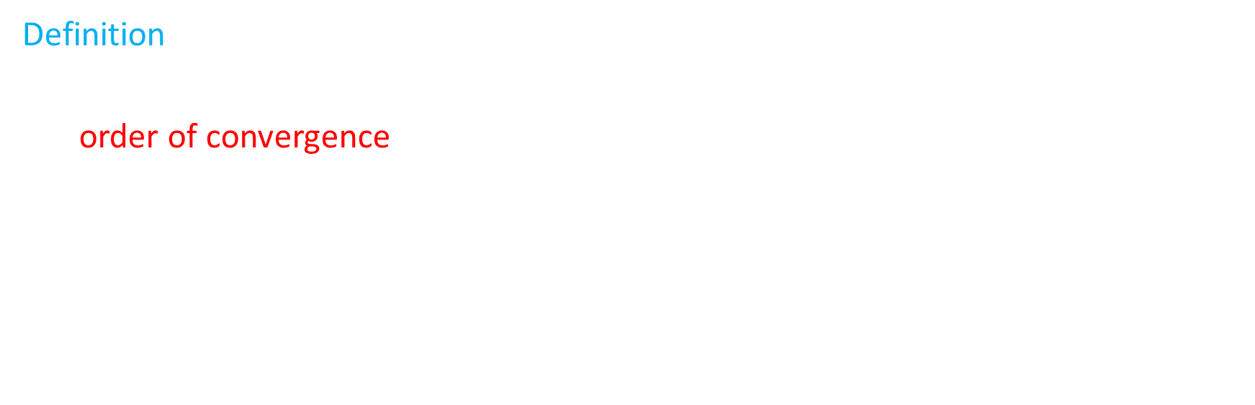

Analysis of Gradient Methods
Definition
Given a sequence $x_{k}$ that converges to $x^{∗}$, that is, $\lim_{k→∞}\left|\left|x_{k}−x^{∗}\right|\right|=0,$we say that the order of convergence is$p$, with $p∈ℛ$, if
$0<\lim_{k→∞}{\frac{|\left|x_{k+1}−x^{∗}\right||}{|\left|x_{k}−x^{∗}\right||^{p}}<∞}.$
If for all $p>0$,
$\lim_{k→∞}{\frac{|\left|x_{k+1}−x^{∗}\right||}{|\left|x_{k}−x^{∗}\right||^{p}}=0}$,
then we say that the order of convergence is $∞$.
$p=1$ and $\lim_{k→∞}{\frac{|\left|x_{k+1}−x^{∗}\right||}{|\left|x_{k}−x^{∗}\right||}=1}$: sublinear
$p=1$ and $\lim_{k→∞}{\frac{|\left|x_{k+1}−x^{∗}\right||}{|\left|x_{k}−x^{∗}\right||}<1}$: linear
$p>1$: superlinear
$p=2:$ quadratic

Slide 12




Analysis of Gradient Methods
Example:
$x_{k}=\frac{1}{k}$, $x_{k}→0$
$x_{k}=γ^{k}$, $0<γ<1,$ $x_{k}→0$
$x_{k}=γ^{q^{k}}$, $0<γ<1, q>1$, $x_{k}→0$
$x_{k}=1, ∀k$, $x_{k}→1$
Recall:
$f=O(g)$, if $∃c$ such that $\left|f\right|≤c|g|$ for sufficiently small$g$
$$o(|\left|x_{k}−x^{∗}\right||^{p})$$
→ strictly greater
than $p$
Theorem:
Let $x_{k}$ be a sequence converging to $x^{∗}$. If $\left|\left|x_{k+1}−x^{∗}\right|\right|=O(|\left|x_{k}−x^{∗}\right||^{p})$, then the order of convergence (if it exists) is at least $p$.

Slide 13


Analysis of Gradient Methods
Example: $f\left(x\right)=x^{2}−\frac{x^{3}}{3}$, fixed-step-size with $α=\frac{1}{2}$, $x_{0}=1$
Theorem
Let $x_{k}$ be a convergent sequence generated by the steepest descent algorithm. Then, the order of convergence of $x_{k}$ is 1 in the worst case; that is, there exists a function$f$and an initial condition $x_{0}$ such that the order of convergence of $x_{k}$ is equal to 1.
Lemma
In the steepest descent algorithm, if $g_{k}≠0, ∀k,$ then $γ_{k}=1$ if and only if $g_{k}$ is an eigenvector of $Q$.

Slide 14
Newton’s Method

Slide 15










Introduction
Recall
$$x_{k+1}=x_{k}−\frac{f′(x_{k})}{f"(x_{k})}$$
Steepest Descent
$$x_{k+1}=x_{k}−α∇f(x_{k})$$
$$f\left(x\right)≈f\left(x_{k}\right)+(x−x_{k})^{T}g_{k}+\frac{1}{2}(x−x_{k})^{T}F(x_{k})(x−x_{k})≜q(x)$$
$$f\left(x\right)$$
$$q(x)$$
Apply FONC to $q(x)$:
$$0=∇q\left(x\right)=g_{k}+F(x_{k})(x−x_{k})$$
$$x_{k+1}=x_{k}−{F(x_{k})}^{−1}g_{k}$$
Example
$f(x_{1},x_{2},$ $x_{3}$, $x_{4})=(x_{1}$+ $x_{2})^{2}+5(x_{3}−x_{4})^{2}+(x_{2}−2x_{3})^{4}+10(x_{1}−x_{4})^{4}$
$$x^{0}=[3,−1,0,1]^{T}$$
$$x_{k}$$
$$x_{k+1}$$
$$x^{∗}$$

Slide 16


Analysis of Newton’s Method
$$x_{k+1}=x_{k}−{F(x_{k})}^{−1}g_{k}$$
consists of
Solve $F\left(x_{k}\right)d_{k}=−g_{k}$
Set $x_{k+1}=x_{k}+d_{k}$
Pro:
Superior convergence property
Con:
$F\left(x_{k}\right)<0$
May not be descent

Slide 17


Convergence of Newton’s Method
$f$ is a quadratic function: $f\left(x\right)=\frac{1}{2}x^{T}Qx−x^{T}b$
$f$ is a general function
Theorem
Suppose that $f∈𝒞^{3}$ and $x^{∗}∈ℛ^{n}$ is a point such that $∇f\left(x^{∗}\right)=0$ and $F(x^{∗})$ is invertible. Then, for all $x_{0}$ sufficiently close to $x^{∗}$, Newton’s Method is well-defined for all $k$ and converges to $x^{∗}$ with an order at least 2.

Slide 18




Analysis of Newton’s Method
Pro:
Superior convergence property
Con:
$F\left(x_{k}\right)<0$
May not be descent
Levenberg-Marquardt modification:
$$x_{k+1}=x_{k}−α_{k}(F(x_{k})+μ_{k})^{−1}g_{k}$$
$$x_{k+1}=x_{k}−α_{k}F(x_{k})^{−1}g_{k}$$
where $α_{k}={argmin}_{α>0}f(x_{k}−αF(x_{k})^{−1}g_{k}$)
Theorem
Let $x_{k}$ be a convergent sequence generated by the Newton’s method. If the Hessian $F\left(x_{k}\right)>0$ and $g_{k}=∇f(x_{k})≠0$, then there exists an $\overline{α}>0$ such that $∀α∈(0,\overline{α})$
$f\left(x_{k}+αd_{k}\right)<f(x_{k})$,
where $d_{k}=−F(x_{k})^{−1}g_{k}=x_{k+1}−x_{k}$.

Slide 19


Nonlinear Least Squares
Minimize $\sum_{i=1}^{m}{(r_{i}(x))^{2}}$
Sinusoid $y=Asin(ωt+θ)$
t
Data Fitting Problem

Slide 20
Conjugate Direction Methods

Slide 21


Introduction
Pro:
Superior convergence property
Con:
$F\left(x_{k}\right)<0$
May not be descent
$$x_{k+1}=x_{k}−{F(x_{k})}^{−1}g_{k}$$
consists of
Solve $F\left(x_{k}\right)d_{k}=−g_{k}$
Set $x_{k+1}=x_{k}+d_{k}$
Evaluation of $F(x_{k})$
Solve $F\left(x_{k}\right)d_{k}=−g_{k}$

Slide 22



Introduction
Definition
Let $Q$ be a real symmetric $n×n$ matrix. The directions $d_{0},d_{1},$ $d_{2},$ …, $d_{k}$ are $Q$-conjugate if for all $i≠j$, we have ${d_{i}}^{T}Qd_{i}=0$.
Lemma
Let $Q$ be a symmetric positive definite $n×n$ matrix. If the directions $d_{0},d_{1},$ $d_{2},$ …, $d_{k}∈ℛ^{n},$ $k≤n−1$, are non-zero and $Q$-conjugate, then they are linearly independent.
Example
Let $Q=\begin{matrix}3 & 0 & 1 \\ 0 & 4 & 2 \\ 1 & 2 & 3\end{matrix}$

Slide 23




Conjugate Direction Algorithm
Minimize $f\left(x\right)=\frac{1}{2}x^{T}Qx−x^{T}b$, where $Q∈ℛ^{n×n}$ is a symmetric positive definite matrix
Basic Conjugate Direction Algorithm
Given a starting point $x_{0}$ and $Q$-conjugate directions $d_{0},d_{1},$ …, $d_{n−1}$:
$g_{k}=∇f\left(x_{k}\right)=Qx_{k}−b$
$α_{k}=−\frac{{g_{k}}^{T}d_{k}}{{d_{k}}^{T}Qd_{k}}$
$x_{k+1}=x_{k}+α_{k}d_{k}$
Example
$$f\left(x\right)=\frac{1}{2}x^{T}\left[\begin{matrix}4 & 2 \\ 2 & 2\end{matrix}\right]x−x^{T}\left[\begin{aligned}−1 \\ 1\end{aligned}\right]$$
Steepest descent:
$$α_{k}=\frac{{g_{k}}^{T}g_{k}}{{g_{k}}^{T}Qg_{k}}$$
$$x_{k+1}=x_{k}−α_{k}g_{k}$$
Theorem
For any starting point $x_{0}$, the basic conjugate direction algorithm converges to the unique $x^{∗}$ (solution of $Qx=b$) in $n$ steps; that is, $x_{n}=x^{∗}$.

Slide 24




Conjugate Direction Algorithm
Lemma
$${g_{k+1}}^{T}d_{i}=0, ∀0≤k<n−1, ∀i≤k$$
Steepest descent:
$$α_{k}={argmin}_{α≥0}f(x_{k}−αg_{k})$$
Basic Conjugate Direction Algorithm
Given a starting point $x_{0}$ and $Q$-conjugate directions $d_{0},d_{1},$ …, $d_{n−1}$:
$g_{k}=∇f\left(x_{k}\right)=Qx_{k}−b$
$α_{k}=−\frac{{g_{k}}^{T}d_{k}}{{d_{k}}^{T}Qd_{k}}$
$x_{k+1}=x_{k}+α_{k}d_{k}$
Lemma
$$α_{k}={argmin}_{α}f(x_{k}+αd_{k})$$
$$\left(α_{0},…,α_{k}\right)=argminf(x_{0}+\sum_{i=0}^{k}{α_{i}d_{i}})$$

Slide 25




Conjugate Gradient Algorithm
Conjugate Direction Algorithm
Given a starting point $x_{0}$ and $Q$-conjugate directions $d_{0},d_{1},$ …, $d_{n−1}$:
$g_{k}=∇f\left(x_{k}\right)=Qx_{k}−b$
$α_{k}=−\frac{{g_{k}}^{T}d_{k}}{{d_{k}}^{T}Qd_{k}}$
$x_{k+1}=x_{k}+α_{k}d_{k}$
Example
$$f\left(x\right)=\frac{3}{2}{x_{1}}^{2}+2{x_{2}}^{2}+\frac{3}{2}{x_{3}}^{2}+x_{1}x_{3}−3x_{1}−x_{3}$$
How to compute?
Set $k:=0$; select $x_{0}$.
$g_{0}=∇f\left(x_{0}\right)$. If $g_{0}=0$, then stop; else, set $d_{0}=−g_{0}$.
$α_{k}=−\frac{{g_{k}}^{T}d_{k}}{{d_{k}}^{T}Qd_{k}}$
$x_{k+1}=x_{k}+α_{k}d_{k}$
$g_{k+1}=∇f\left(x_{k+1}\right)$. If $g_{k+1}=0$, then stop.
$β_{k}=\frac{{g_{k+1}}^{T}Qd_{k}}{{d_{k}}^{T}Qd_{k}}$
$d_{k+1}=−g_{k+1}+β_{k}d_{k}$
Set $k:=k+1$; go to step 3.
Proposition
In Conjugate Gradient Algorithm, the directions $d_{0},d_{1},$ …, $d_{n−1}$ are $Q$-conjugate.

Slide 26






Conjugate Gradient Algorithm
Set $k:=0$; select $x_{0}$.
$g_{0}=∇f\left(x_{0}\right)$. If $g_{0}=0$, then stop; else, set $d_{0}=−g_{0}$.
$α_{k}=−\frac{{g_{k}}^{T}d_{k}}{{d_{k}}^{T}Qd_{k}}$
$x_{k+1}=x_{k}+α_{k}d_{k}$
$g_{k+1}=∇f\left(x_{k+1}\right)$. If $g_{k+1}=0$, then stop.
$β_{k}=\frac{{g_{k+1}}^{T}Qd_{k}}{{d_{k}}^{T}Qd_{k}}$
$d_{k+1}=−g_{k+1}+β_{k}d_{k}$
Set $k:=k+1$; go to step 3.
Nonquadratic problems
Known: $g_{k}$
Unknown: $Q$
Solutions:
Line search $α_{k}={argmin}_{α≥0}f(x_{k}+αd_{k})$
Formulas for $β$:
Fletcher-Reeves:
$$β_{k}=\frac{{g_{k+1}}^{T}g_{k+1}}{{g_{k}}^{T}g_{k}}$$
Polak-Ribiѐre:
$$β_{k}=\frac{{g_{k+1}}^{T}(g_{k+1}−g_{k})}{{g_{k}}^{T}g_{k}}$$
Hestenes-Stiefel:
$$β_{k}=\frac{{g_{k+1}}^{T}(g_{k+1}−g_{k})}{{d_{k}}^{T}(g_{k+1}−g_{k})}$$

Slide 27
Quasi-Newton Methods

Slide 28





Introduction
Pro:
Superior convergence property
Con:
$F\left(x_{k}\right)<0$
May not be descent
Newton’s Method
$$x_{k+1}=x_{k}−{F(x_{k})}^{−1}g_{k}$$
consists of
Solve $F\left(x_{k}\right)d_{k}=−g_{k}$
Set $x_{k+1}=x_{k}+d_{k}$
Evaluation of $F(x_{k})$
Solve $F\left(x_{k}\right)d_{k}=−g_{k}$
Set $k:=0$; select $x_{0}$.
$g_{0}=∇f\left(x_{0}\right)$. If $g_{0}=0$, then stop; else, set $d_{0}=−g_{0}$.
$α_{k}=−\frac{{g_{k}}^{T}d_{k}}{{d_{k}}^{T}Qd_{k}}$
$x_{k+1}=x_{k}+α_{k}d_{k}$
$g_{k+1}=∇f\left(x_{k+1}\right)$. If $g_{k+1}=0$, then stop.
$β_{k}=\frac{{g_{k+1}}^{T}Qd_{k}}{{d_{k}}^{T}Qd_{k}}$
$d_{k+1}=−g_{k+1}+β_{k}d_{k}$
Set $k:=k+1$; go to step 3.
Levenberg-Marquardt modification:
$$x_{k+1}=x_{k}−α_{k}(F(x_{k})+μ_{k})^{−1}g_{k}$$
where $α_{k}={argmin}_{α≥0}f(x_{k}−α(F(x_{k}{)+μ_{k})}^{−1}g_{k}$)

Slide 29



Introduction
Levenberg-Marquardt modification:
$$x_{k+1}=x_{k}−α_{k}(F(x_{k})+μ_{k})^{−1}g_{k}$$
where $α_{k}={argmin}_{α≥0}f(x_{k}−α(F(x_{k}{)+μ_{k})}^{−1}g_{k}$)
Approximation of the inverse Hessian
$$x_{k+1}=x_{k}−α_{k}H_{k}g_{k}$$
where $α_{k}={argmin}_{α≥0}f(x_{k}−α{H_{k}g}_{k}$)
Proposition
Let $f∈𝒞^{1}, x_{k}∈ℛ^{n}, g_{k}=∇f\left(x_{k}\right)≠0$, and $H_{k}$ an $n×n$ real symmetric positive definite matrix. If we set $x_{k+1}=x_{k}−α_{k}H_{k}g_{k}$, where $α_{k}={argmin}_{α≥0}f(x_{k}−α{H_{k}g}_{k}$), then $α_{k}>0$ and $f\left(x_{k+1}\right)<f(x_{k})$.

Slide 30



Approximation of the Inverse Hessian
Quasi-Newton Method:
$d_{k}=−H_{k}g_{k}$
$α_{k}={argmin}_{α≥0}f(x_{k}+αd_{k}$)
$x_{k+1}=x_{k}+α_{k}d_{k}$
$H_{0},H_{1},…$ are symmetric
Remark
In the quadratic case, $H_{i}$’s with $0≤i≤k$ are required to satisfy $H_{k+1}∆g_{i}=∆x_{i}$, where $∆x_{i}=x_{i+1}−x_{i}=α_{i}d_{i}$ and $∆g_{i}=g_{i+1}−g_{i}=Q∆x_{i}$ .
Theorem
Consider a quasi-Newton method applied to a quadratic function with Hessian $Q=Q^{T}$ such that for $0≤k<n−1, H_{k+1}∆g_{i}=∆x_{i}, ∀0≤i≤k$ and $H_{k+1}={H_{k+1}}^{T}$. If $α_{i}≠0, ∀0≤i≤k$, then $d_{0}, d_{1},…,d_{k+1}$ are $Q$-conjugate.

Slide 31


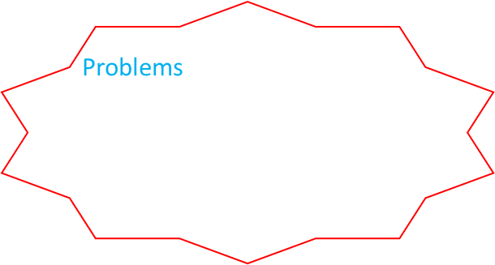



Rank One Algorithm
Problems
$H_{k+1}$ may not be positive definite
The evaluation of ${∆g_{k}}^{T}(∆x_{k}−H_{k}∆g_{k})$
Set $k:=0$; select $x_{0}$ and a real symmetric positive definite $H_{0}$
If $g_{k}=0$, stop; else, $d_{k}=−H_{k}g_{k}$
Compute $α_{k}={argmin}_{α≥0}f(x_{k}+αd_{k}$) and $x_{k+1}=x_{k}+α_{k}d_{k}$
Compute
$$∆x_{k}=α_{k}d_{k}, ∆g_{k}=g_{k+1}−g_{k}$$
$$H_{k+1}=H_{k}+\frac{(∆x_{k}−H_{k}∆g_{k})(∆x_{k}−H_{k}∆g_{k})^{T}}{{∆g_{k}}^{T}(∆x_{k}−H_{k}∆g_{k})}$$
Set $k:=k+1$; go to Step 2.
Rank one correction formula
$$H_{k+1}=H_{k}+a_{k}z_{k}{z_{k}}^{T}$$
where $a_{k}∈ℛ$ and $z_{k}∈ℛ^{n}$.
Theorem
For the rank one algorithm applied to a quadratic function with Hessian $Q=Q^{T}$, we have $H_{k+1}∆g_{i}=∆x_{i}, ∀0≤i≤k$.
Example
$$f\left(x\right)={x_{1}}^{2}+\frac{1}{2}{x_{2}}^{2}+3$$
$d_{i}$’s are $Q$-conjugate, solvable in $n$steps

Slide 32




DFP Algorithm
Set $k:=0$; select $x_{0}$ and a real symmetric positive definite $H_{0}$
If $g_{k}=0$, stop; else, $d_{k}=−H_{k}g_{k}$
Compute $α_{k}={argmin}_{α≥0}f(x_{k}+αd_{k}$) and $x_{k+1}=x_{k}+α_{k}d_{k}$
Compute
$$∆x_{k}=α_{k}d_{k}, ∆g_{k}=g_{k+1}−g_{k}$$
$$H_{k+1}=H_{k}+\frac{∆x_{k} {∆x_{k}}^{T}}{{∆x_{k}}^{T}∆g_{k}}−\frac{[H_{k}∆g_{k}][H_{k}∆g_{k}]^{T}}{{∆g_{k}}^{T}H_{k}∆g_{k}}$$
Set $k:=k+1$; go to Step 2.
Example
$$f\left(x\right)=\frac{1}{2}x^{T}\left[\begin{matrix}4 & 2 \\ 2 & 2\end{matrix}\right]x−x^{T}\left[\begin{aligned}−1 \\ 1\end{aligned}\right]$$
Theorem
For the DFP algorithm applied to a quadratic function with Hessian $Q=Q^{T}$, we have $H_{k+1}∆g_{i}=∆x_{i}, ∀0≤i≤k$.
Theorem
Suppose $g_{k}≠0.$ In the DFP, if $H_{k}>0$, then $H_{k+1}>0$.

Slide 33




BFGS Algorithm
DFP algorithm:
$$H_{k+1}∆g_{i}=∆x_{i}, ∀0≤i≤k$$
Quadratic problems:
$$g_{k}=∇f\left(x_{k}\right)=Qx_{k}−b$$
$$Q^{−1}∆g_{k}=∆x_{k}$$
Approximation of the inverse Hessian
BFGS algorithm:
$$∆g_{i}=B_{k+1}∆x_{i}, ∀0≤i≤k$$
Quadratic problems:
$$g_{k}=∇f\left(x_{k}\right)=Qx_{k}−b$$
$$∆g_{k}=Q∆x_{k}$$
Approximation of the Hessian
$$H_{k+1}=(B_{k+1})^{−1}=H_{k}+\left(1+\frac{∆{g_{k}}^{T}H_{k}∆g_{k}}{{{∆g}_{k}}^{T}∆x_{k}}\right)\frac{∆x_{k} {∆x_{k}}^{T}}{{∆x_{k}}^{T}∆g_{k}}−\frac{H_{k}∆g_{k}{∆x_{k}}^{T}+(H_{k}∆g_{k}{∆x_{k}}^{T})^{T}}{{{∆g}_{k}}^{T}∆x_{k}}$$

Slide 34
Solving Linear Equations

Slide 35







Least-Squares Analysis
Input
$$Ax=b$$
where $A∈ℛ^{m×n}$, $b∈ℛ^{m}$, $m≥n$, and rank $A=n$
Output
A vector (least-squares solution) $x∈ℛ^{n}$ minimizing $||Ax−b{||}^{2}$
$$h$$
$$b$$
Lemma
Let $A∈ℛ^{m×n}$, $m≥n$. Then, rank $A=n$ if and only if rank $A^{T}A=n$.
$$R(A)⊂ℛ^{m}$$
Theorem
The unique vector $x^{∗}$ that minimized $||Ax−b{||}^{2}$ is given by the solution to the equation $A^{T}Ax=A^{T}b$; that is, $x^{∗}=(A^{T}A)^{−1}A^{T}b\text{.}$
Proposition
Let $h∈R\left(A\right)$ be such that $h−b$ is orthogonal to $R\left(A\right)$. Then, $h=Ax^{∗}=A(A^{T}A)^{−1}A^{T}b.$

Slide 36


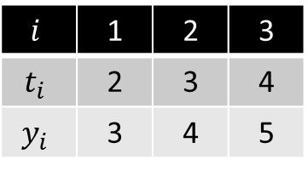

Least-Squares Analysis
Another way
$$f\left(X\right)=||Ax−b||^{2}$$
$=(Ax−b)^{T}(Ax−b)$
$=\frac{1}{2}x^{T}\left(2A^{T}A\right)x−x^{T}\left(2A^{T}b\right)+b^{T}b$
FONC
$∇f\left(x\right)=$ $\left(2A^{T}A\right)x−$ $2A^{T}b=0$
$$x^{∗}=(A^{T}A)^{−1}A^{T}b\text{.}$$
Example 1
2 types of concrete
Type 1: 30% cement, 40% gravel, 30% sand
Type 2: 10% cement, 20% gravel, 70% sand
5 pounds cement, 3 pounds gravel, 4 pounds sand
Example 2
$$i$$ | 1 | 2 | 3
$$t_{i}$$ | 2 | 3 | 4
$$y_{i}$$ | 3 | 4 | 5
$$y=mt+c$$

Slide 37


Recursive Least-Squares Algorithm
Known: $A_{0}, b_{0}, x_{0}={G_{0}}^{−1}{A_{0}}^{T}b, G_{0}={A_{0}}^{T}A_{0}$
Minimize:
$$||\left[\begin{aligned}A_{0} \\ A_{1}\end{aligned}\right]x−\left[\begin{aligned}b_{0} \\ b_{1}\end{aligned}\right]{||}^{2}$$
$$P_{k+1}=P_{k}−P_{k}{A_{k+1}}^{T}(I+A_{k+1}P_{k}{A_{k+1}}^{T})^{−1}A_{k+1}P_{k}$$
$x_{k+1}=x_{k}+P_{k+1}$ ${A_{k+1}}^{T}(b_{k+1}−A_{k+1}x_{k})$

Slide 38



Linear Equation with Minimum Norm
$$minimize \left|\left|x\right|\right|$$
subject to $Ax=b$
where $A∈ℛ^{m×n}, b∈ℛ^{m}, m≤n, rank A=m$
Theorem
The unique solution $x^{∗}$ to $Ax=b$ that minimizes the norm $\left|\left|x\right|\right|$ is given by
$x^{∗}=A^{T}(AA^{T})^{−1}b$.
Example
$$x_{1}+2x_{2}−x_{3}=1$$
$$4x_{1}+x_{2}+3x_{3}=0$$

Slide 39



Kaczmarz’s Algorithm
Let ${a_{j}}^{T}$ be the $j$th row of $A$, $b_{j}$ the $j$th component of $b$, and $μ$ a scalar with $0<μ<2$
Set $i≔0$, initial condition $x_{0}$
For $j≔1, …, m$, set
$$x_{im+j}≔x_{im+j−1}+μ(b_{j}−{a_{j}}^{T}x_{im+j−1})\frac{a_{j}}{{a_{j}}^{T}a_{j}}$$
Set $i≔i+1$; go to Step 2.
Theorem
In Kaczmarz’s algorithm, if $x_{0}=0$, then $x_{k}→x^{∗}=A^{T}(AA^{T})^{−1}b$ as $k→∞$.
Example
$$A=\left[\begin{matrix}1 & −1 \\ 0 & 1\end{matrix}\right], b=\left[\begin{aligned}2 \\ 3\end{aligned}\right]$$

Slide 40


Solving Linear Equations in General
Given $Ax=b$
$A∈ℛ^{n×n}$, rank $A=n$: $x^{∗}=A^{−1}b$
$A∈ℛ^{m×n}$, $m≥n$, rank $A=n$: $x^{∗}=(A^{T}A)^{−1}A^{T}b$
$A∈ℛ^{m×n}$, $m≤n$, rank $A=m$: $x^{∗}=A^{T}(AA^{T})^{−1}b$
$A∈ℛ^{m×n}$, rank $A=r≤min⁡\{m,n\}$: ?
Definition
Given $A∈ℛ^{m×n}$, a matrix $A^{†}∈ℛ^{n×m}$ is called a pseudoinverse of $A$ if
$AA^{†}A=A$,
and there exist matrices $U∈ℛ^{n×n}, V∈ℛ^{m×m}$ such that
$A^{†}=UA^{T}$ and $A^{†}=A^{T}V$.

Slide 41



Pseudoinverse
Theorem
Let $A∈ℛ^{m×n}$. If a pseudoinverse $A^{†}$ of $A$ exists, then it is unique.
Lemma [full-rank factorization]
Let $A∈ℛ^{m×n}$, rank $A=r≤min⁡\{m,n\}$. Then, there exist $B∈ℛ^{m×r}$, $C∈ℛ^{r×n}$ such that $A=BC$, where rank $A= rank B =$rank $C$.
Theorem
Let $A∈ℛ^{m×n}$ have a full-rank factorization $A=BC$ with rank $A=$rank $B=$ rank $C=r$, $B∈ℛ^{m×r}$, $C∈ℛ^{r×n}$. Then $A^{†}=B^{†}C^{†}$, where $B^{†}=(B^{T}B)^{−1}B^{T}$ and $C^{†}=C^{T}(CC^{T})^{−1}$.

Slide 42


Pseudoinverse
Example
$$A=\left[\begin{matrix}2 & 1 & −2 & 5 \\ 1 & 0 & −3 & 2 \\ 3 & −1 & −13 & 5\end{matrix}\right]$$
Theorem
Consider a system of linear equations $Ax=b$, $A∈ℛ^{m×n}$, rank $A=r$. The vector $x^{∗}=A^{†}b$ minimizes $||Ax−b{||}^{2}$ on $ℛ^{n}$. Furthermore, among all vectors in $ℛ^{n}$ that minimizes $||Ax−b{||}^{2}$, the vector $x^{∗}=A^{†}b$ is the unique vector with minimal norm.

Slide 43
Unconstrained Optimization and Neural Networks

Slide 44

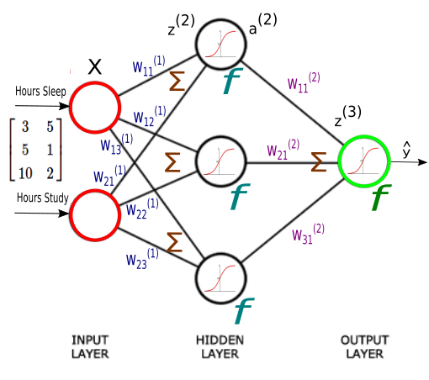
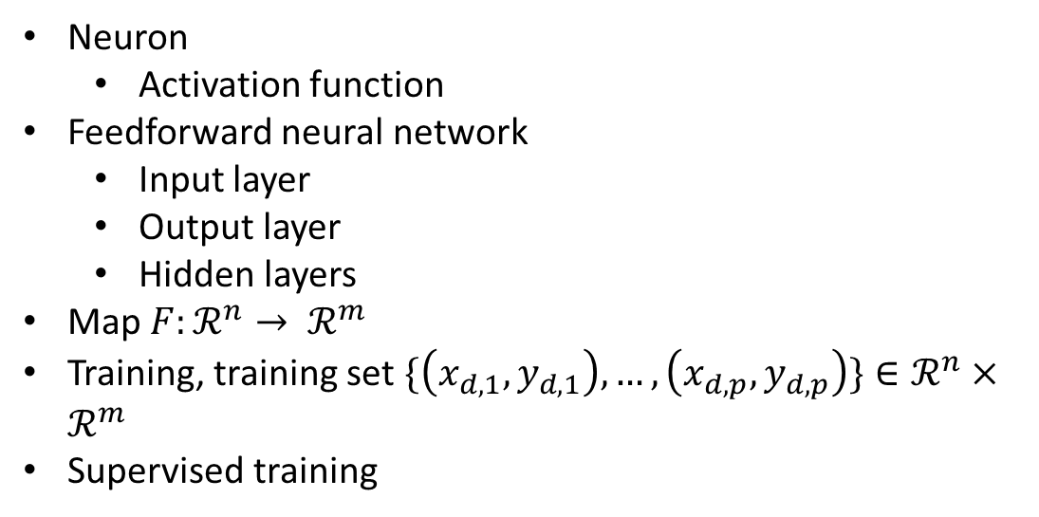
Neuron
Activation function
Feedforward neural network
Input layer
Output layer
Hidden layers
Map $F:ℛ^{n}→ ℛ^{m}$
Training, training set $\{\left(x_{d,1}, y_{d,1}\right),…,\left(x_{d,p},y_{d,p}\right)\}∈ℛ^{n}×ℛ^{m}$
Supervised training

Slide 45



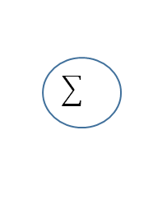





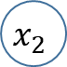



Single-Neuron Training
$$x_{1}$$
$$w_{1}$$
$$w_{2}$$
$$y$$
$$x_{2}$$
$$w_{3}$$
$$x_{3}$$
Activation = identity
Minimize $\frac{1}{2}\sum_{i=1}^{p}{(y_{d,i}−{x_{d,i}}^{T}w)^{2}}$
where $w=[w_{1},…,w_{n}]^{T}∈ℛ^{n}$
Map $y=\sum_{i=1}^{n}{w_{i}x_{i}=x^{T}w}$
Training set
$\{\left(x_{d,1}, y_{d,1}\right),…,\left(x_{d,p},y_{d,p}\right)\}∈ℛ^{n}×ℛ$
Case 1 [$p≤n,$rank ${x_{d}}^{T}=p$]: Adaline (adaptive linear element)
Minimize $\frac{1}{2}||y_{d}−{X_{d}}^{T}w{||}^{2}$
where $y_{d}∈ℛ^{p}, X_{d}∈ℛ^{n×p}$
Case 2 [$p>n,$rank ${x_{d}}^{T}=p$]:

Slide 46
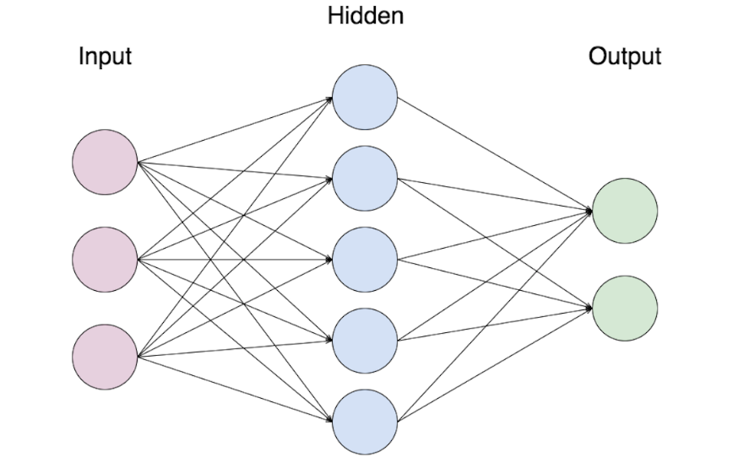


Backpropagation Algorithm
Input: $x_{i}, i=1,..,n$
Output: $y_{s}, s=1,..m$
Hidden: $z_{j}, j=1,..,l$
Activation function of hidden layer: $f_{j}^{h}:ℛ→ℛ, j=1,..,l$
Activation function of output layer: $f_{s}^{o}:ℛ→ℛ, s=1,..,m$
Weights from inputs to hidden layer: $w_{ji}^{h},i=1,..,n, j=1,..,l$
Weights from hidden layer to outputs: $w_{sj}^{o}, j=1,..,l, s=1,..,m$
Map $F:ℛ^{n}→ℛ^{m}$
$$v_{j}=\sum_{i=1}^{n}{w_{ji}^{h}}x_{i}$$
$$z_{j}=f_{j}^{h}(v_{j})$$
$$y_{s}=f_{s}^{o}(\sum_{j=1}^{l}{w_{sj}^{o}z_{j}})$$

Slide 47
Global Search Algorithms

Slide 48
Introduction
Gradient methods
Newton’s method
Conjugate gradient methods
Quasi-Newton methods
Initial point
First derivative
Methods from combinatorial optimization
Only objective function
Good initial point

Slide 49


Nelder-Mead Simplex Algorithm
Definition
A simplex is a geometric object determined by an assembly of $n+1$ points, $p_{0},p_{1},…,p_{n}$, in the $n$-dimensional space such that
$det\left[\begin{matrix}p_{0} & p_{1} & … & p_{n} \\ 1 & 1 & … & 1\end{matrix}\right]≠0$.

Slide 50










Nelder-Mead Simplex Algorithm
Minimize $f(x)$ with $x∈ℛ^{2}$
$$p_{nl}$$
Initial point $x_{0}=p_{0}$ and $p_{i}=p_{0}+λ_{i}e_{i}, i=1,2$
Sort $p_{i}$’s, $f\left(p_{s}\right)≤f\left(p_{nl}\right)≤f(p_{l})$
$$p_{g}$$
$p_{r}=p_{g}+ρ(p_{g}−p_{l})$
$$p_{l}$$
Compute $centroid p_{g}=\sum_{i=0}^{n−1}{\frac{p_{i}}{n}}$
$$p_{e}$$
reflection
Compute $p_{r}=p_{g}+ρ(p_{g}−p_{l})$ (e.g., $ρ=1$)
$$p_{s}$$
If $f\left(p_{s}\right)≤f\left(p_{r}\right)<f\left(p_{nl}\right)$, then replace $p_{l}$ by $p_{r}$, and go to Step 2.
expansion
If $f\left(p_{r}\right)<f(p_{s})$, then compute $p_{e}=p_{g}+ε(p_{r}−p_{g})$ (expansion coefficient $ε>1$, e.g., $ε=2$). If $f\left(p_{e}\right)<f\left(p_{r}\right)$, then replace $p_{l}$ by $p_{e}$; else $p_{l}$ by $p_{r}$. Go to Step 2.

Slide 51








Nelder-Mead Simplex Algorithm
$$p_{nl}$$
$$p_{g}$$
$$p_{r}$$
$$p_{l}$$
Outside contraction
$$p_{c}$$
$$p_{c}$$
If $f\left(p_{r}\right)≥f(p_{nl})$, then
If $f\left(p_{r}\right)<f(p_{l})$, then compute $p_{c}=p_{g}+γ(p_{r}−p_{g})$ (contraction coefficient $0<γ<1$, e.g., $γ=1/2$).
If $f\left(p_{r}\right)≥f(p_{l})$, then compute $p_{c}=p_{g}+γ(p_{l}−p_{g})$
If $f(p_{c})<f(p_{l})\text{,}$ then
replace replace $p_{l}$ by $p_{c}$ and go to Step 2;
Else
Keep $p_{0}=p_{s}$ and set $p_{i}≔p_{s}+σ(p_{i}−p_{0})$, $i=1,..,n, σ=1/2$. Go to Step 2
$$p_{s}$$
Inside contraction
failure
shrinkage

Slide 52



Simulated Annealing
Minimize $f(x)$
Subject to $x∈Ω$
Assumptions
We can select at random an initial point $x_{0}$ in Ω
We can select at random a point in $N(x)$
Naïve Random Search Algorithm
Set $k:=0$. Select an initial $x_{0}∈Ω$
Pick a random point $z∈N(x_{k})$
If $f\left(z\right)<f(x_{k})$, then $x_{k+1}=z$; else, $x_{k+1}=x_{k}.$
If stopping criterion satisfied, then stop
Set $k≔k+1$; go to Step 2.
Stuck around local minimizer
Larger neighborhood
Climb out of the region

Slide 53
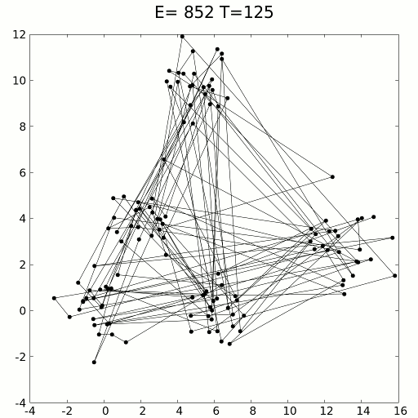




Simulated Annealing
Simulated Annealing Algorithm
Set $k:=0$. Select an initial $x_{0}∈Ω$
Pick a random point $z∈N(x_{k})$
Toss a coin with Prob(HEAD)=$p(k,f\left(z\right),f\left(x_{k}\right)).$ If HEAD, set $x_{k+1}=z$; else, $x_{k+1}=x_{k}.$
If stopping criterion satisfied, then stop
Set $k≔k+1$; go to Step 2.
$$p\left(k,f\left(z\right),f\left(x_{k}\right)\right)=$$
$$min⁡\{1,exp⁡(−\frac{f\left(z\right)−f\left(x_{k}\right)}{T_{k}}\}$$
Remark
Keep track of best so far $x_{k}^{best}$
Temperature $T_{k}$ cooling down
e.g., $T_{k}=\frac{γ}{\log{k+2}}$

Slide 54
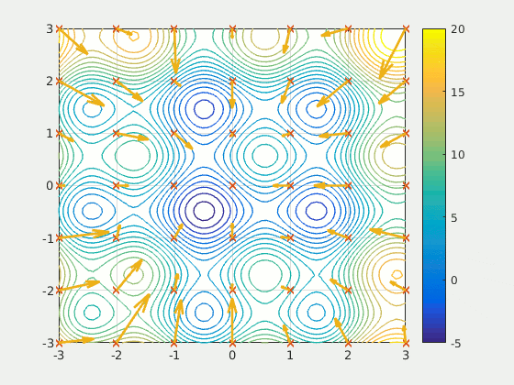

Particle Swarm Optimization
Basic idea:
a population of candidate solutions
moving these particles around in the search space with own position and velocity
Each particle's movement is influenced by its local best known position, but is also guided toward the best known positions
$d$ particles $1,..,d$;
$x_{i}$: $i$’s position
$v_{i}:i$’s velocity
$p_{i}:i$’s personal best position
$g$: global best position
Hadamard product: $A°B$

Slide 55



Particle Swarm Optimization
Set $k:=0$. For $i=0,..,d$, generate initial random positions $x_{i}^{0}$ and velocities $v_{i}^{0}$, and $p_{i}^{0}=x_{i}^{0}$. Set $g^{0}≔argmin\{f\left(x\right)\}$
For $i=0,..,d$, generate random $n$-vectors $r_{i}^{k}$ and $s_{i}^{k}$ with components uniformly in $(0,1)$, and set
$$v_{i}^{k+1}=ωv_{i}^{k}+c_{1}r_{i}^{k}°\left(p_{i}^{k}−x_{i}^{k}\right)+c_{2}s_{i}^{k}°\left(g^{k}−x_{i}^{k}\right)$$
$$x_{i}^{k+1}=x_{i}^{k}+v_{i}^{k+1}$$
For $i=0,..,d$, if $f\left(x_{i}^{k+1}\right)<f(p_{i}^{k})$, then set $p_{i}^{k+1}=x_{i}^{k+1}$; else $p_{i}^{k+1}=p_{i}^{k}$
If $∃i$ with $f\left(x_{i}^{k+1}\right)<f(g^{k})$, then set $g^{k+1}=x_{i}^{k+1}$; else $g^{k+1}=g^{k}$
If stopping criterion satisfied, then stop
Set $k≔k+1$, go to Step 2
Inertial constant
Slightly less than one
Cognitive constant
$c_{1}≈2$
Social constant
$c_{2}≈2$

Slide 56
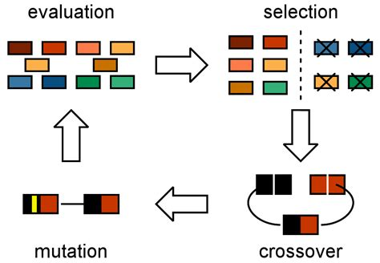


Genetic Algorithms
Evolutionary algorithms
Bio-inspired operations: mutation, crossover, selection
Maximize $f(x)$
Subject to $x∈Ω$
Initial population $P(0),$population size $N$
Chromosomes and representation scheme
Mating pool $M(k)$

Slide 57
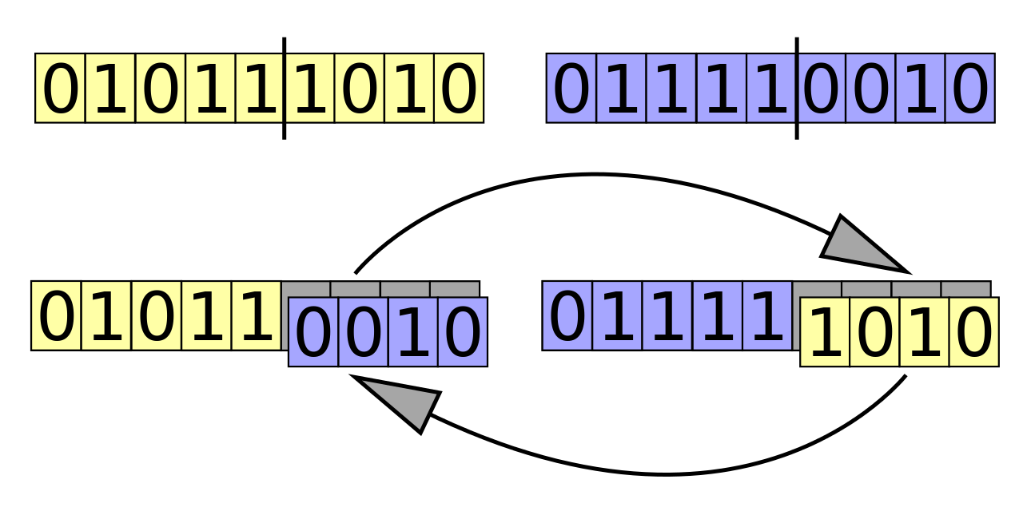



Genetic Algorithms
Selection scheme:
Roulette-wheel: prob$(m_{k}=p_{k})=\frac{f(x_{k})}{F(k)}$, $F\left(k\right)=\sum{f(x_{k})}$
Tournament scheme: pick randomly a pair of chromosomes
Evolution
Crossover:
Pick randomly $2k$ chromosomes from $M(k)$
One-point crossover
Mutation
Take each chromosome and randomly change each symbol with a given probability $p_{m}$ (e.g., $p_{m}≈0.01$）

Slide 58
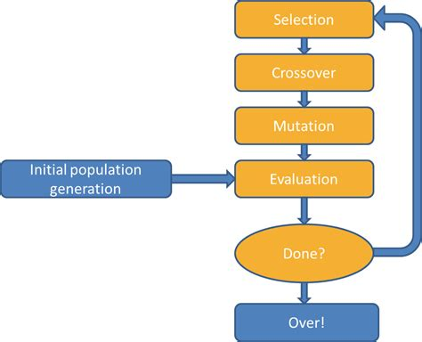

Genetic Algorithms
Set $k≔0$. Generate an initial population $P(0)$.
Evaluate $P(k)$
If the stopping criterion satisfied, then stop.
Select $M(k)$from $P(k).$
Evolve $M(k)$ to form $P(k)$.
Set $k:=k+1$, go to Step 2.

